Slide 1
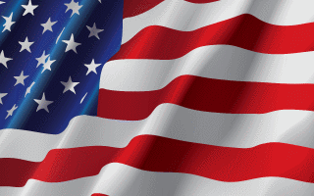
4 United States Code § 8(a) – Sign of Distress

Slide 2
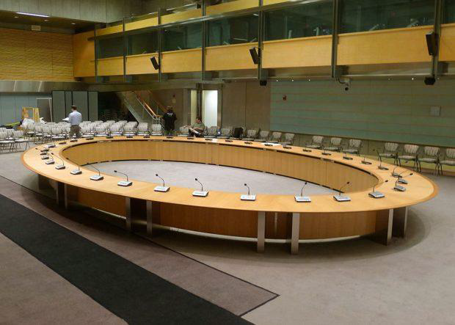
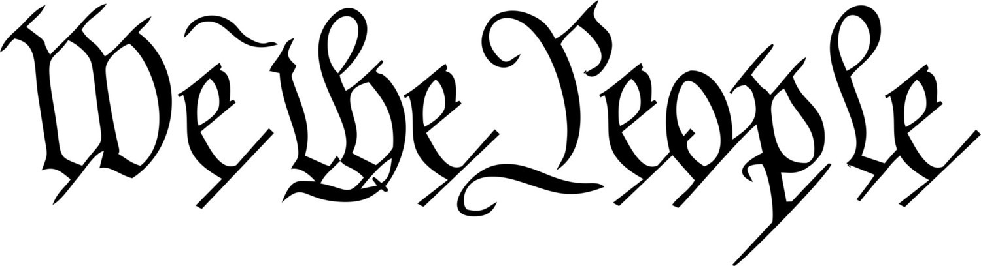
INTRODUCTION TO THE
COUNTY COMMITTEE OF SAFETY
SPONSORED BY National Liberty Alliance

Slide 3
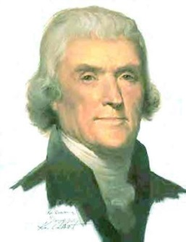
Committees Of Safety
Are the Only Solution
National Liberty Alliance would like to bring the concept of County Committees of Safety to the attention of all the People of the United States.
Committees of Safety ARE the Solution to America’s problem of out of control governments. These are on the rise all across America. National Liberty Alliance is already established in every state, it is a forgone conclusion our current campaign to alert and share concepts with Liberty Minded Groups, in order to unite and prepare America to weather any storm the New World Order can raise.
Thomas Jefferson said, “An enlightened citizenry is indispensable for the proper functioning of a republic. Self-government is not possible unless the citizens are educated sufficiently to enable them to exercise oversight. It is therefore imperative that the nation see to it that a suitable education be provided for all its citizens.“ --
Thus it is the Committees of Safety that must Educate the People... Protect People... Provide for the safety of the People... that is what a Committee of Safety does.

Slide 4
Committees Of Safety
What Are They
Committee – is a group of People who considers and manages any matter.
Safety – is freedom from danger, injury, or damage; it is safe keeping.
Therefore, by definition, a Committee of Safety, would be People who feel obligated to volunteer to consider or manage the matter of safety and to include the aspects of freedom from danger, injury, or damage, and the safe keeping of Liberty.
When we revisit the pre “United States Constitutional Body Politic” by the People for the era of 1760-1789 and understand the function of a Committee of Safety, we see that a present-day application going forward needs to be enacted across the nation to “Reinstate Our Founding Principles.”
In 1774, Some Committees, such as the one in Worchester County, threatened to declare independence from British rule unless the Massachusetts government restored its original Charter. On April 12, 1775 (just one week before the Battle of Lexington/Concord), John Hancock, President of the Massachusetts Provincial Congress (later, the Massachusetts Provincial Committee of Safety) requested that “ALL Counties, Towns and Districts” form Committees of Safety.

Slide 5
Committees Of Safety
What Are They
Committees of Safety are community assembles established in the absence of the ability of the existing government to provide for the needs of civilized society.
Committees of Safety, historically speaking, empowered the people at the grass roots to return control of their local government to the People.
“From Slave to a Self-Rule Mindset;” resulted from the publication of a single document, “Common Sense” by Thomas Paine, published January 10, 1776.
His best seller was read by every colonist in America, all 3 million, or it was read to them if they were illiterate. This single document did more to form this country than any other document at that time. It pumped new life into the colonies and gave everyone hope for a brave new future. By mid year of 1776 the formal “Declaration of Independence” was drafted and making its way through the colonies for signatures and ratification, passing into law thus initiating the America experiment with a “Natural Law Republican Form of Government.”

Slide 6
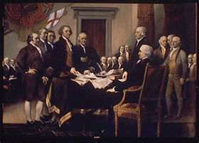
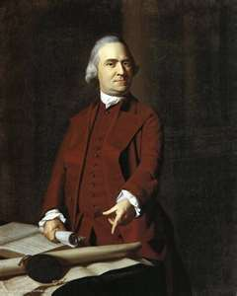
Committees Of Safety
What Are They
Committees of Safety are community governance established in the absence of the ability of the existing governments to provide for the needs of civilized society.
Committees of Safety are the civil bodies politic.
On the voyage from England to America, the Pilgrims created a civil body politic called “The Mayflower Compact.”
Jamestown also had a “Civil Body Politic.”
Samuel Adams said, “If ever a time should come when vain and aspiring men shall possess the highest seats in government, our country will be in need of its experienced patriots to prevent its ruin.”

Slide 7
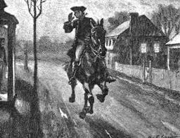
Committees Of Safety
In Times of Trouble
Cambridge April 29, 1775
This may certify that the bearer, Mr. Paul Revere is messenger to the Committee of Safety and that all dispatch and assistance be given him in Instances that the business of the Colony may be facilitated
Jos. Warren, Chair.

Slide 8

Committees Of Safety
In Times of Trouble
Committees of Safety formed early on in the colonies to create legislative bodies because the King failed to provide governing laws necessary to provide for the common good.
Committees of Safety sent Benjamin Franklyn to Britain for a redress of grievances.
Committees of Safety planned and executed the Boston Tea Party.
In 1774, the various Committees of Safety called for the First Continental Congress. Delegates to that Congress went from town, to county, to Provincial level Committees, before being selected to go to Philadelphia.
In Western Massachusetts, Committees of Safety forced the resignations of judges appointed under the Massachusetts Government Act (1774).
Committees of Safety called for the 2nd Continental Congress deciding on Independence.
Committees of Safety produced the Declaration of Independence
Committees of Safety governed during the War for Independence
Committees of Safety debated and executed the US Constitution in 1789
Committees of Safety debated and executed the Bill of Rights in 1791

Slide 9
Committees Of Safety
Todays Times of Trouble
As we saw previously our Founders did the things necessary to achieve goals that moved forward to solve problems. What are we doing to solve problems? They say the definition of insanity is doing the same thing over and over and expecting different results.
Voting will not save our Republic because party bosses control who gets on the ballot and more often than not it’s the criminal on the left or the criminal on the right. And the counting of the votes are fraudulent.
Courts will not save our Republic because the Judges are owned and paid for to maintain the status quo.
Going to Rally’s will not save our Republic because after the event everyone goes home and nothing is accomplished.
Going to Meetings will not save our Republic because People don’t know what to do to bring government back under the Constitution and people eventually dwindle away.
Demonstrating and sign waving will not save our Republic because everybody honks their horn and People feel better and nothing is really accomplished.
Complaining will not save our Republic because bureaucrats just ignore us and People don’t know what to do about it.
Supporting candidates will not save our Republic because it’s too few and they usually end up being controlled or corrupted.
NationalLibertyAlliance.org

Slide 10
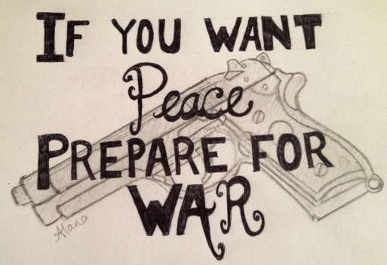
Committees Of Safety
Be Prepared
NOW is the Time to institute County Committees of Safety and address issues, which government ignores or inadequately or wrongfully addresses.
The concept of Committees of Safety is rapidly spreading across the Country as a result of the degradation of social, political and economic conditions.
The neighborhood, second to the family, is the most basic level of community life. Alarmingly the institutionalized concept of problem management has reduced neighborly interdependence and self-reliance to the lowest level ever seen in American history.
Everyone is encouraged to contribute their individual experience to the whole of the community.
 Elders and Seniors have experience and wisdom to contribute.
 VFW, DAV, American Legionnaires have a history and heart to serve.
 The service of each person in the community combines to assure that Life, Liberty and the Pursuit
of Happiness continues for their posterity.
 Retired Veterans have already served and may wish to service again as able when needed.
Each county needs all able-bodied to join an existing militia or start one. Demand the fulfillment of the Constitutional obligation of the government to adequately arm and regulate the militia. Should the government fail to do so, the Committee of Safety must meet the need to prepare now to defend their county and Liberty.
Tomorrow may be too late!

Slide 11
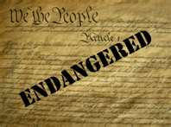
Committees Of Safety
Be Prepared
We Must Empower the People at the Grass Roots to take control of their local government and their State and Federal Representatives by requiring them to obey the “Supreme Law of the Land” just like our Founding Fathers!!!
U.S. Constitution Article VI Clause 2: This Constitution, and the laws of the United States which shall be made in pursuance thereof; and all treaties made, or which shall be made, under the authority of the United States, shall be the ‘Supreme Law of the Land;’ and the judges in every state shall be bound thereby, anything in the Constitution or laws of any State to the contrary notwithstanding.
Article III Section 2. The judicial power shall extend to all cases, in Law and equity,
Rodriques v. Ray Donavan - "All codes, rules, and regulations are for government authorities only, not human/Creators in accordance with God's laws and are lacking due process…".
Self v. Rhay – “The common law is the real law, the Supreme Law of the land, the code, rules, regulations, policy and statutes are “not the law”,
Marbury v. Madison - "All laws, rules and practices which are repugnant to the Constitution are null and void"
Our Constitution is in danger. We must reclaim our Constitution from all attacks foreign and domestic for ourselves, family, neighbors and our posterity! The service and experience of each person in the community IS NEEDED NOW, Let us Never Surrender!!!

Slide 12
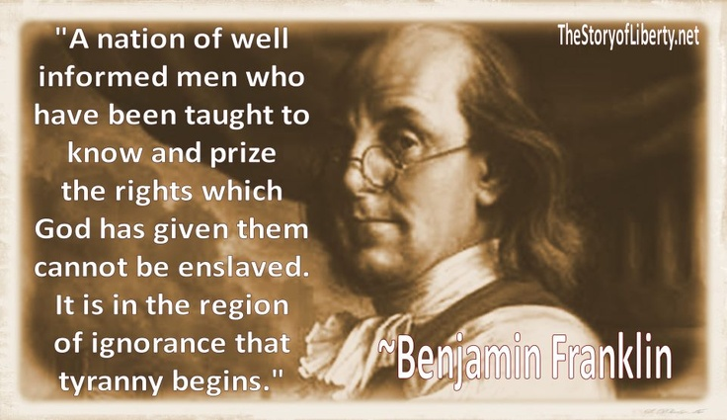
President Trump said, “In America, the people govern, the people rule, and the people are sovereign. I was elected not to take power, but to give power to the American people, where it belongs;”
The problem is that the People don’t know how to take and implement that power!
NationalLibertyAlliance.org

Slide 13
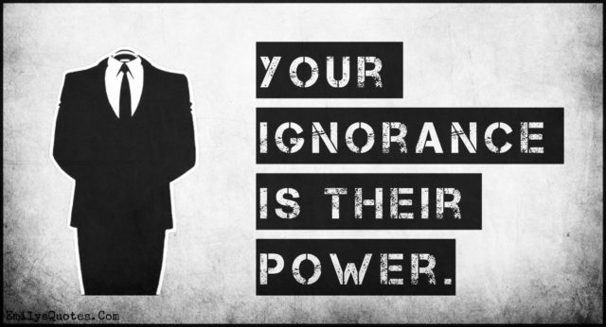
Thomas Jefferson said, If a nation expects to be ignorant and free in a
state of civilization, it expects what never was and never will be.
NationalLibertyAlliance.org

Slide 14
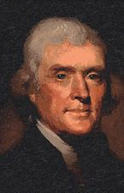
“I know no safe depositary of the ultimate powers of the society but the people themselves; and if we think them not enlightened enough to exercise their control with a wholesome discretion, the remedy is not to take it from them, but to inform their discretion by education. This is the true corrective of abuses of constitutional power….
An enlightened citizenry is indispensable for the proper functioning of a republic. Self-government is not possible unless the citizens are educated sufficiently to enable them to exercise oversight. It is therefore imperative that the nation see to it that a suitable education be provided for all its citizens.
Educate and inform the whole mass of the people... They are the only sure reliance for the preservation of our liberty."
Thomas Jefferson
Common Law is the Science of Government by Consent!
We the People must Learn the Science of Government by Consent!
Or Perish!!!
NationalLibertyAlliance.org

Slide 15
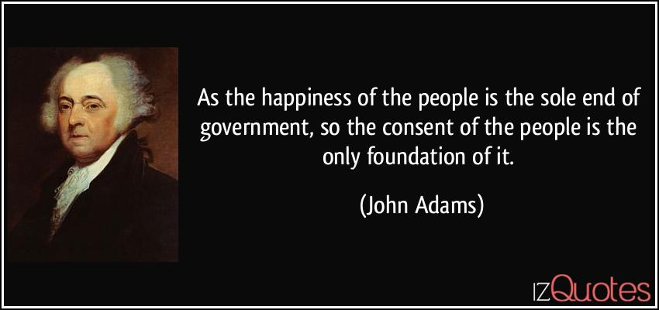
Committees of Safety Protected, Saved, & Served the Pilgrims
Committees of Safety protected, Saved & Served the Colonist during British rule
Committees of Safety protected, Saved & Served the Colonist during the Revolution
Committees of Safety Created the United States of America
Committees of Safety Guided the United States of America
Committees of Safety can Save the United States of America
Committees of Safety Is “Government by Consent”
We hold these truths to be self-evident, that all men are created equal, that they are endowed by their Creator with certain unalienable Rights, that among these are Life, Liberty and the pursuit of Happiness.--That to secure these rights, Governments are instituted among Men, deriving their just powers from the consent of the governed.

Slide 16
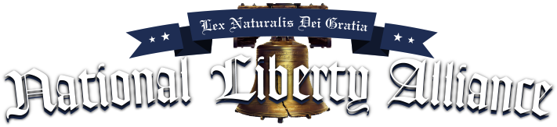
The purpose of NLA is to facilitate an education in order to provide for a Free and Independent grassroots' organization in every county. And provide for communication between the counties and the states thereby building a National Alliance for Liberty capable of bringing government back under the Consent of We the People.
NLA believes that Government by Consent must be controlled at the grassroots level via the COS. NLA will provide all the tools necessary for the People to have Gov by Consent.
NLA Provided Handbooks & Instructions
COS Handbook
COS Committeeman Handbook
Jurist Handbook
Sheriffs Handbook
Common Law Handbook
Militia Codes and Rules
COS Charter
COS RESOLUTION
COS Vow
Found under our “Peoples’ Duty” Tab
NLA Provided Courses
Civics Course
Constitutional Course
Militia Course
Government By Consent Course
Found under our “Courses” Tab
And a further Education under our “Education” Tab.
Thomas Jefferson said, "we in America do not have government by the majority. We have government by the majority who participate".

Slide 17
God Bless America
10 min - Intermission

Slide 18
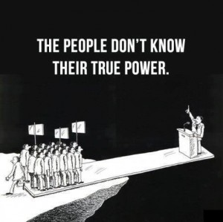
COUNTY COMMITTEE OF SAFETY
IS “GOVERNMENT BY CONSENT
COS COMPOSITION
GENERAL COMMITTEE
⬄ Chairman ⬄ Co-Chairman ⬄ Secretary ⬄ Treasurer
When you have about 15 People (committeemen) establish a Charter & Resolution
After you accomplish the aforesaid make contact with your Sheriff
SUB COMMITTEES
Committee of Correspondence
Political Action Committee
Judiciary Committee
Education Committee
Militia Committee
Other Committees as determined by the General Committee
Step by step instructions to set up a COS can be found at
www.nationallibertyalliance.org

Slide 19
COUNTY COMMITTEE OF SAFETY
Purpose is to organize the People in their county in order to prevent government encroachment. The common goal of each county is to teach the People, what they forgotten, “Government by Consent”! This requires an understanding of how a “Natural Law Republic” was established by the providence of nature’s God and how it works. This can only be accomplished by a proper education as we organize.
Everyone in the COS should be taking NLA courses “found under the “Educational” tab, click on “START HERE.” NLA provides the following courses ⬄ Foundation course ⬄ Civics course ⬄ Constitution course ⬄ Militia course ⬄ Government by Consent course and ⬄ Jury Administrators course. If we don’t know these things how can we know elected, appointed, or hired bureaucrats are obeying the Law of the Land and honoring their oaths?
THE PEOPLE MUST RESTORE
 The Law of the Land”
 Our Common Law Courts
 Common Law Grand & Petit Jurys
 Equity Courts
 Rules of Common Law
 Restore the Political Process
 County Militia
 Constitutional Sheriffs
 Lawful Money
 Proper Education
 Heritage
 Force a Republic Review
This can only be accomplished by We The People
At the Grassroots!!!
NationalLibertyAlliance.org

Slide 20

COUNTY COMMITTEE OF SAFETY
IS “GOVERNMENT BY CONSENT
GENERAL COMMITTEE
The General Committee is organized to prevent government encroachment. The common goal of each county is to teach the People, what they forgotten, “Government by Consent”!
The General Committee is responsible for building membership in the COS. Obviously there is no limit to the number of People who would like to join the COS. The goal is to endeavor to achieve a membership of 250 People as quickly as possible, [this is the average number of committeemen in each county] therefore the committee should brain storm different ways to grow membership. One way is for every member to bring a guest to the next meeting. 250 People is the ideal number to achieve the work without putting to much on any one person.
The General Committee is responsible for contacting local government to encourage them to cooperate with the People or start the process of recall for those who refuse.
The General Committee is responsible to initiate all the necessary sub-committees discussed below and should pass the donation can at every meeting or agree on dues to cover expenses.
NationalLibertyAlliance.org

Slide 21
COUNTY COMMITTEE OF SAFETY
IS “GOVERNMENT BY CONSENT
COMMITTEE OF CORRESPONDENCE
This sub-committee is responsible for addressing unconstitutional government activity and correspond with other committees of correspondence in order to share solutions and work on problems that affect other counties within your state or across our Nation.
This sub-committee is also responsible for working with the “Political Action Committee” during the Primaries in order to coordinate with other Counties the walking of “Designating Petitions” to fill political vacancies for the general election with Statesmen.
This sub-committee is also responsible for registering and communicating with NLA’s Director of Correspondence who can assist with solving problems, legal challenges, education, etc.
National Liberty Alliance will assist and advise only when asked and will never interfere with the issues effecting a County Committee of Safety unless asked. NLA is only assisting in the development of COS’s in all 3,133 Counties in order to save our Republic. NLA hopes that all COS’s endeavor to organize in the offered framework provided in order to have uniformity and thereby be able to communicate and work with their neighboring COS’s and occasionally their statewide COS’s.
NationalLibertyAlliance.org

Slide 22
COUNTY COMMITTEE OF SAFETY
IS “GOVERNMENT BY CONSENT
POLITICAL ACTION COMMITTEE
This sub-committee is responsible for taking on the responsibility as Committeemen, presently the Committeeman process is codified and controlled by party bosses that serve the “Deep State” and not the People. Common Law liberates the People while the present system is repugnant to Liberty as it suppresses the will of the People.
This sub-committee is responsible for working with all political sub-division (such as town, village, congressional, state senate, etc.) with other County Political Committees to set a time and place for interviewing candidates to fill political vacancies.
This sub-committee is also responsible for monitoring our elected officials and contact them for correction when they violate their oath. And if necessary work with all related COS’s within the political subdivision for “Recall.”
This sub-committee reports the interview dates to the “General Committee” for notification to all COS members who have a duty to attend the interviews for candidates within their respective political subdivisions and walk designating petitions for candidates they support to get them on the ballot.
SEE the “COS Committeeman Handbook” at www.nationallibertyalliance.org/handbooks for in-depth instructions on the Committeeman process. All People should have the opportunity to participate in this process without party restrictions and exclusions. NLA will provide instructional videos and support for this important political process.
NationalLibertyAlliance.org

Slide 23
COUNTY COMMITTEE OF SAFETY
IS “GOVERNMENT BY CONSENT
JUDICIARY COMMITTEE
This sub-committee is responsible for filling Jury Administrative positions whenever there is a vacancy. Each county needs four Jury Administrators and one Paralegal Secretary. These are paid positions and require special training. NLA will provide that training and certification. These Administrators will work together in every county to restore the Law of the Land by resurrecting common law and common law rules in our courts.
This sub-committee will be responsible to fill “Jury Administrator” vacancies with certified individuals. Jury Administrators may be employed as they go through the certification process. But they must be progressing through their certification. It is the duty of this committee to monitor that progression.
This sub-committee will be responsible to judge any charges made by other Administrators against an Administrator who violates their “vow” for consideration of removal from office.
This sub-committee is responsible for assisting People with problems with bureaucrats or legal matters that the “General Committee” is unable to solve and refer them to the Jury Administrators for Justice if necessary.
NationalLibertyAlliance.org

Slide 24
COUNTY COMMITTEE OF SAFETY
IS “GOVERNMENT BY CONSENT
EDUCATION COMMITTEE
This sub-committee is responsible for encouraging and assisting members in their education.
This sub-committee is responsible for visiting grammar schools, high schools and colleges to move them to teach our children civics and the Constitution. NLA will soon be working on a suitable curriculum in Civics, American History, Common Law and our Founding Documents.
Federal law passed in 2004 requires that all schools that receive federal funding provide a course to all students on the Constitution. The law is known as H.R. 4818, and the text is found at section 111 (b): This legislation is weak but We the People can demand more from our children’s schools.
NationalLibertyAlliance.org

Slide 25
COUNTY COMMITTEE OF SAFETY
IS “GOVERNMENT BY CONSENT
MILITIA COMMITTEE
This sub-committee is responsible for restoring the organized and unorganized militia within their respective county, it is the duty of every COS member to participate. If an existing militia exists within your county invite them to work with and help the COS in this endeavor.
We are to look to former military and law enforcement for assistance in organizing and training. See Militia Handbook at www.NationalLibertyAlliance.org for detailed information and instructions and contact NLA’s Militia Director who will assist with solving problems, legal challenges, etc. It is extremely important for county militias to be corresponding with other county militia committees and plan a coordinated yearly state wide event.
NationalLibertyAlliance.org

Slide 26
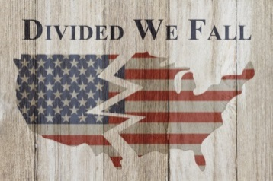
WE MUST END POLITICAL PARTIES
In 1796, George Washington in his Farewell Address warned us that, “through the course of time cunning, ambitious, and unprincipled men would subvert the power of the people and seize for themselves the reins of government (the COS Committeeman) through private Associations. He went on to tell us that once they seized the reins of power [using the statutory committeeman controlled by party bosses and not the People] the parties (private associations) that would arise would;
(1) destroy the very engines (the political process) which have lifted them to unjust dominion,
(2) destroy the regular deliberation and action of the constituted authorities,
(3) open the door to foreign influence and corruption, thus the policy and the will of one country will be subjected to the policy and will of another,
(4) serve to organize division,
(5) ruin public liberty,
(6) stifle, control and repress,
(7) foment occasional riots & insurrection,
(8) kindle animosity of one part against another,
(9) put in the place of the delegated will of the nation, the will of the party elite,
(10) agitate the community with ill founded jealousies & false alarms,
(11) undermine the Constitution which could not be directly overthrown,
(12) distract the public councils and enfeeble the public administration,
(13) drive the spirit of revenge,
(14) leads to despotism”. Washington concluded, “…parties are truly your worst enemy”.
NationalLibertyAlliance.org

Slide 27

WE MUST END POLITICAL PARTIES
Our Founding Fathers were uneasy about political parties. They believed that parties had the potential to tear the new nation apart. To these men, political parties meant factionalism, which they believed, could be fatal to the development of the United States as a unified country.
John Adams in letter to Johnathan Jackson, 1780 said, “There is nothing which I dread so much as a division of the republic into two great parties, each arranged under its leader, and concerting measures in opposition to each other. This, in my humble apprehension, is to be dreaded as the greatest political evil under our Constitution.”
Thomas Jefferson in 1789 said, “I never submitted the whole system of my opinions to the creed of any party of men whatever in religion, in philosophy, in politics, or in anything else where I was capable of thinking for myself. Such an addiction is the last degradation of a free and moral agent. If I could not go to heaven but with a political party, I would decline to go.”
The generally hostile attitude toward political parties was articulated most forcefully by James Madison in Federalist paper 10; there, he argued that one of the most important functions of a “well-constructed Union” was to break and control the “violence of factions [parties].” Madison clearly understood the enormous dangers that could attach to the founding of political parties in America. And it is because of attitudes like Madison's, widely shared as they were among many of the delegates to the Philadelphia Convention, that political parties were excluded from the US Constitution.
NationalLibertyAlliance.org

Slide 28
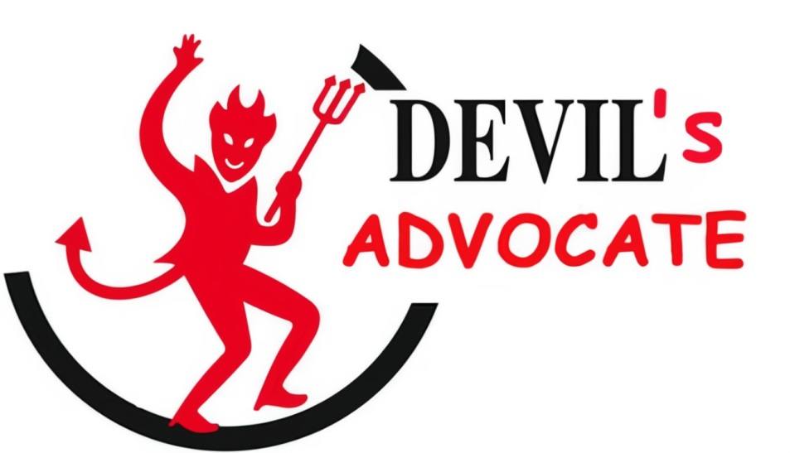
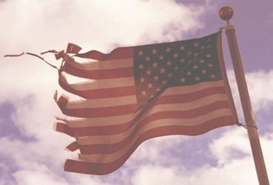
WE MUST END THE AMERICAN BAR ASSOCIATION
THE
In 1750, the British BAR was established in the colonies to abrogate the Common Law and suppress the beginning of the American rebellion instigated by Benjamin Franklin.
In 1878, seventy-five lawyers hell-bent on the destruction of our Constitutional Republic established the American Bar Association which played a pivotal role in the abrogation of our common law.

Slide 29

THE AMERICAN BAR ASSOCIATION THE
The ABA has seized control of our government at every level through the Deep State; whereas, no decision is made, no law is passed and no issue is resolved without the seditious BAR orchestrated legislation intended to regulate our Liberties and eventually abolish them; a necessity for their NWO.
In 1819, the original ratified 13th Amendment that prevented BAR members from holding an office of trust was removed by the ABA controlled Congress and replaced with another in 1865.
In 1868, the ABA controlled Congress through the 14th Amendment set the stage to abrogate our unalienable rights changing them into civil rights calling them privileges and immunities, to place the people under civil law.
In 1871, the ABA controlled Congress created a foreign state within a state within a city (Washington DC) through the Organic act of placing the United States under the control of foreigners via the deep state.
In 1913 the ABA controlled Congress removed the states right of suffrage through the Senate thereby enslaving the states through the “unratified” and anti-constitutional 17th Amendment.
NationalLibertyAlliance.org

Slide 30
THE AMERICAN BAR ASSOCIATION THE
In 1913, the ABA controlled Congress enslaved the People under the Federal Reserve Act which gave complete control of the dollar to foreign bankers subjecting the People to debtor’s prison.
In 1922, the NY ABA announced that it planned a vigorous state-wide campaign to abolish the Grand Jury institution.
In 1934 the ABA controlled Congress passed the “Rules Enabling Act,” whereas according to the Federal Judicial Center, a government agency, on September 16, 1938, pursuant to its fictional authority under the repugnant “Rules Enabling Act” stated, “the Supreme Court enacted uniform rules of procedure for the federal courts. Under the new rules, suits in equity and suits at common law were grouped together under the term “civil action,” claiming that “rigid application of common-law rules brought about injustice.”
In 1947, the ABA controlled Congress initiated the national police state surveillance grid. Today, the CIA is a private corporation which operates as a prostitute for global banking interests and does not represent the United States.
In 1948, the ABA controlled Congress created the United Nations on American soil marking the beginning of the end of political sovereignty in the United States.
NationalLibertyAlliance.org

Slide 31
THE AMERICAN BAR ASSOCIATION THE
In 1950, the 81st Congress Investigated the Lawyers Guild and determined that the ABA organization was founded and run by communists. Thus any elected official that is a member of the ABA will only be loyal to the ABA and not the people. (See 81st Congress Report No. 3123).
In 1962, the ABA controlled Congress outlawed prayer in the classroom, marking the beginning of moral decay in America.
In 2001, the ABA controlled Congress passed the Patriot Act and now today virtually every communication that we engage in is monitored.
In 2002, the ABA controlled Congress established the Department of Homeland Security, TSA and FEMA which during a national emergency controls every resource, every asset and even our freedom.
In 2012 the ABA controlled Congress via Title 8 USC 1481, 1952 declared patriots willing to defend the Constitution to be terrorists.
The ABA controlled Congress have flooded our courts with nearly 150 years of repugnant acts, statutes and rules. All of the aforesaid destructive acts were possible because People being ignorant of their duties were not paying attention to what their government was doing.
NationalLibertyAlliance.org

Slide 32
THE AMERICAN BAR ASSOCIATION THE
“The only remedy to lawlessness is the Law.” Therefore, We the People have the power to nullify all these unconstitutional repugnant acts simply through self-education and taking control of the judiciary through the Jury process and our political process through “Committees of Safety.”
Today the ABA is one of the world’s largest professional organizations, with nearly 400,000 members and more than 3,500 entities.
Today the ABA holds a monopoly over the minds of the federal and states judiciaries and attorneys that practice law in our courts. There are 204 ABA accredited law schools nationally and graduates of these schools may generally sit for the bar exam in any state.
There are 31 law schools that have not been approved by the American Bar Association. Some states permit graduates of these schools to take the bar examination or will admit to their bars a graduate of a non-ABA-approved law school who has been admitted to the bar of another state. Most states do not.
NationalLibertyAlliance.org

Slide 33
THE AMERICAN BAR ASSOCIATION THE
THE ABA SCHOOLS, in an act of treason, teach that “In law”, common law is the body of law derived from judicial decisions of courts and similar tribunals. Claiming that the defining characteristic of “common law” is that it arises as precedent.
Whereas Common Law is “NOT” precedent or legislated law, where one size fits all, it is NOT civil law. Common Law a/k/a Natural Law is governed by “maxims” written in the hearts of men. Rom 2:14-15
Today, with almost 500,000 BAR members, 80,000 of them are working in Washington DC. They have perverted the rule of law, deprived We the Sovereign People of due process and have supplanted our Article III courts with jurisdictions unknown.
NationalLibertyAlliance.org

Slide 34
THE AMERICAN BAR ASSOCIATION THE
18 U.S. Code § 2385 - Advocating overthrow of Government: … Whoever, with intent to cause the overthrow or destruction the government of the United States or the government of any State, Territory, District or Possession thereof, or the government of any political subdivision therein, prints, publishes, edits, issues, circulates, sells, distributes, or publicly displays any written or printed matter advocating, advising, or teaching the duty, necessity, desirability, or propriety of overthrowing or destroying any government in the United States by force or violence, or attempts to do so; … shall be fined under this title or imprisoned not more than twenty years, or both, and shall be ineligible for employment by the United States or any department or agency thereof, for the five years next following his conviction.
18 U.S. Code §2381 - Treason: Whoever, owing allegiance to the United States, levies war against them or adheres to their enemies, giving them aid and comfort within the United States or elsewhere, is guilty of treason and shall suffer death, or shall be imprisoned not less than five years and fined under this title but not less than $10,000; and shall be incapable of holding any office under the United States.
SOLUTION: Force the reinstatement of the “Original 13th Amendment that was ratified by our founding fathers in 1818, and execute the Law!
NationalLibertyAlliance.org

Slide 35
CAMPAIGN FOR CONSTITUTIONAL SHERIFFS
“A Sheriff can and should interpose for his citizens against an
overreaching federal, state or local government” – Sheriff Brad Rogers
Thomas Jefferson said, "The purpose of government is to enable the people of a nation to live in safety and happiness. Government exists for the interests of the governed, not for the governors. "It is the duty of a fully informed Sheriff to secure the "safety and happiness" of the People.
Government 'FAILED' in their duty to assure a proper education in our schools. It is the duty of the People to educate themselves and their Sheriff. This is the purpose of NLA through our “Campaign for Constitutional Sheriffs.” Abraham Lincoln said “America will never be destroyed from the outside. If we falter and lose our freedoms, it will be because we destroyed ourselves,” through “lack of knowledge.”

Slide 36
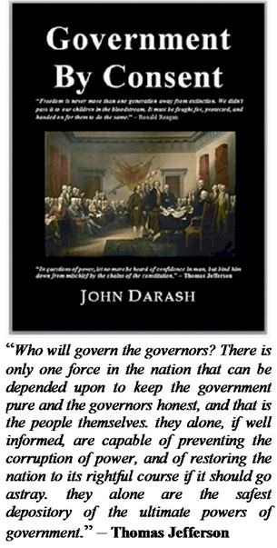
CAMPAIGN FOR CONSTITUTIONAL SHERIFFS
Our goal is to send a copy of the book, "Government by Consent" to every Sheriff in America and to follow up with a COS to support our Sheriff. We must educate all our 3,133 Sheriffs and the People in order to secure our Republic.
The Sheriff has a duty to protect the unalienable rights that are codified by We the People in the Constitution. The office of Sheriff was created through Natural Law to protect the sovereign.

Slide 37
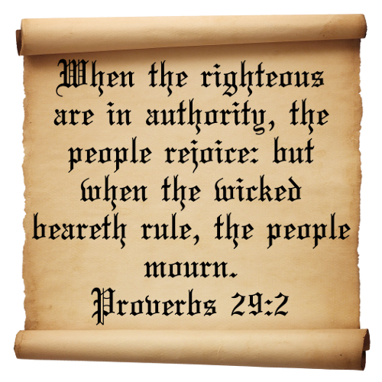
THE SOVEREIGN MAKES THE LAW
James Madison, “The people have an indubitable, unalienable, and indefeasible right to reform or change their Government, whenever it be found adverse or inadequate to the purposes of its institution.”
Samuel Adams, “The natural liberty of man is to be free from any superior power on Earth, and not to be under the will or legislative authority of man, but only to have the law of nature for his rule.”
Thomas Jefferson, “When injustice becomes law, resistance becomes duty.… If a government, either by malfeasance or neglect, fails to protect those rights - or, even worse, if the government itself begins to violate those rights - then it is the right and duty of the people to regain control of theirs affairs and set up a form of government which will serve the people better.”…“These rights which have been bestowed by the Creator, they cannot be altered or eliminated at any time; that is, they cannot be taken away or violated without the offender coming under the judgment and wrath of the Creator.”
NationalLibertyAlliance.org

Slide 38
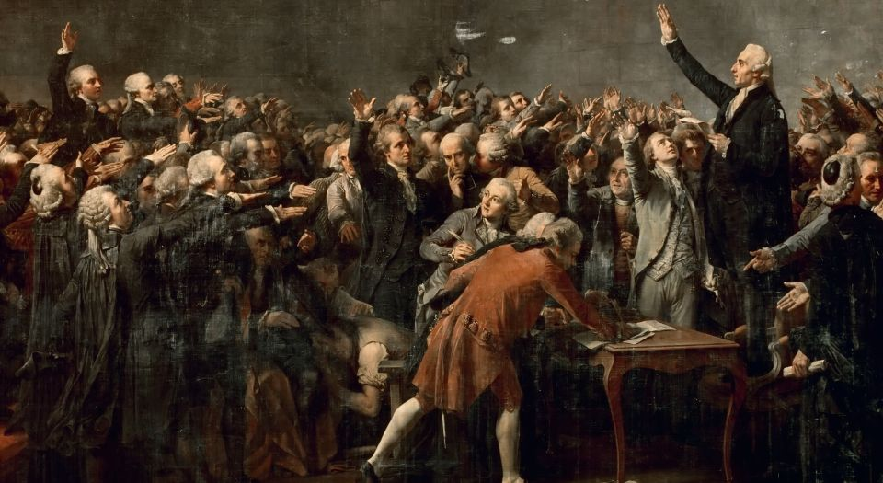
THE SOVEREIGN MAKES THE LAW
We the People have been providentially entrusted via Natural Law to dispense justice and were provided legal recourse to address the criminal conduct of the Judiciary and our Representatives.
“Under our system of government upon the individuality and intelligence of the [sovereign] citizen, the state does not claim to control them, except as his/her conduct to others, leaving him/her the sole judge as to all that affects them.” - Mugler v. Kansas 123 U.S. 623, 659-60
“Every man is independent of ‘all legislative laws, except those prescribed by nature. He is not bound by any institutions formed by his fellowman without his consent.” - Cruden v. Neale, 2 N.C. 338 (1796)
The very meaning of ‘sovereignty’ is that the decree of the sovereign, [not the government], makes law. A consequence of this prerogative is the legal ubiquity of the King [of kings]. His majesty [God] in the eye of the law is always present in all his [Natural Law] courts, though he cannot personally distribute justice. His judges [jurists] are the mirror by which the King’s image [God’s will] written in their hearts is reflected; for “laws are made for us; we are not made for the laws.” - American Banana Co. v. United Fruit Co., 29 S.Ct. 511, 513, 213 U.S.
NationalLibertyAlliance.org

Slide 39
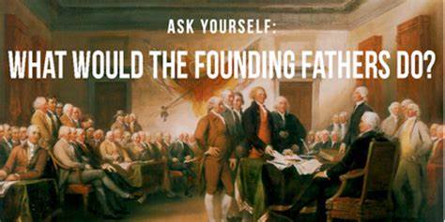
YOU! ARE THE ONLY SOLUTION!
Governments derive their just powers from the consent of the governed,
Therefore, when a long train of abuses and usurpations “Expresses a Design” to bring the People under absolute Despotism, it is their Right, it is their Duty, to throw off such Government, and to provide new Guards.
Reality is the way one perceives it and today we have an entire Nation that perceives Fiction as the Law! Only an enlightened People can change that! As the Lord said;
My people are destroyed for lack of knowledge: Hosea 4:6
There is only one way We the People can save our Republic, only one !
COMMITTEES OF SAFETY
Start a Committee of Safety in your County today!!!
We already know what they did, they organized Committees of Safety and took control of their own government!!!
Will You?
NationalLibertyAlliance.org

Slide 40
Join Our Campaign for Constitutional Sheriffs
Join us to save our Republic by learning the science of government by consent
Come to our weekly live open forum every Monday 9PM EST to Midnight
Take our free Foundational course
Learn real American History
Take our free Civics course
Take our free Militia course
Take our Government by Consent course
Learn how to file a court case
Learn the difference between Law and equity
Learn the Constitution
Learn Natural Law a/k/a Common Law
Learn true meaning of Liberty
Learn how We the People can reinstate our Natural Law Courts of Justice
Thomas Jefferson said, "If a nation expects to be ignorant and free in a state of civilization, it expects what never was and never will be…. An enlightened citizenry is indispensable for the proper functioning of a republic. Self-government is not possible unless the citizens are educated sufficiently to enable them to exercise oversight. It is therefore imperative that the nation see to it that a suitable education be provided for all its citizens…. Educate and inform the whole mass of the people... They are the only sure reliance for the preservation of our liberty."
SAVE OUR REPUBLIC - Start a Committee of Safety in Your County!

